Slide 1
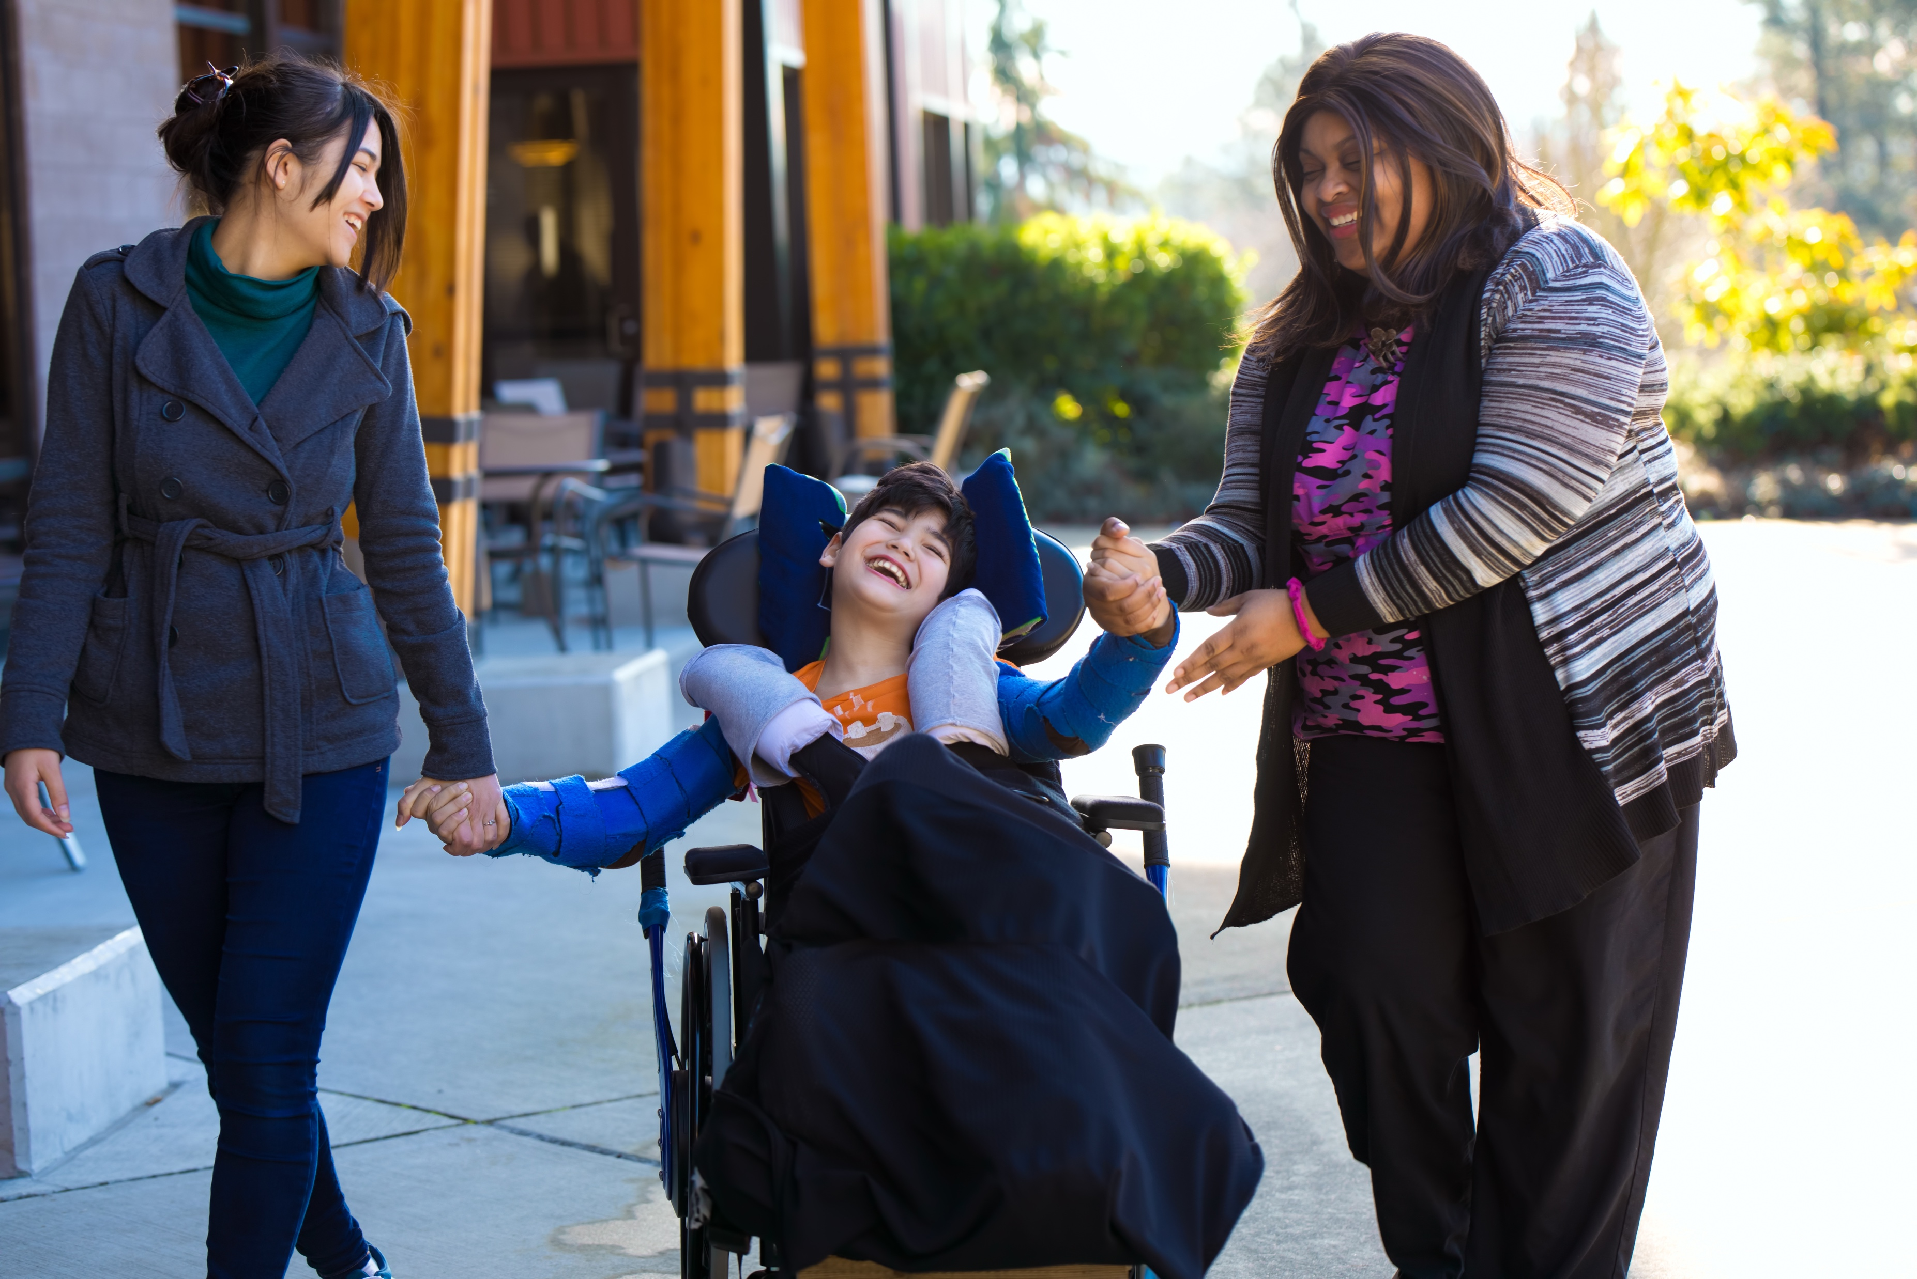
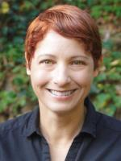
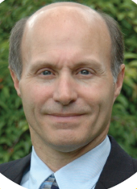
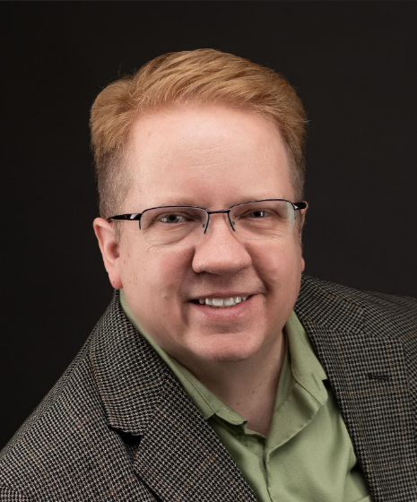
Conveners
Dana Litwin
Craig Young
Global Giving Platform
The Next Generation of Social Philanthropy
Todd McMullin
Notes:
Welcome! Today we’ll embark together on a journey to the future of giving. This presentation has been years in the making. It began in 2006 when the Congress of Volunteer Association Administrators formed the Association of Leaders in Volunteer Engagement, represented here today by the incomparable Ms. Dana Litwin. Between 2008-2016 we participated in hundreds of conversations about the future of the volunteerism profession and how technology could help. In 2017 more than 500 professionals, including several of you here today, convened in the Twin Cities for a National Summit during which we acknowledged that if our profession fails to adapt itself to new ways of thinking and the technologies that reinforce these we will become increasingly irrelevant. It was a sobering but empowering moment.

Slide 2
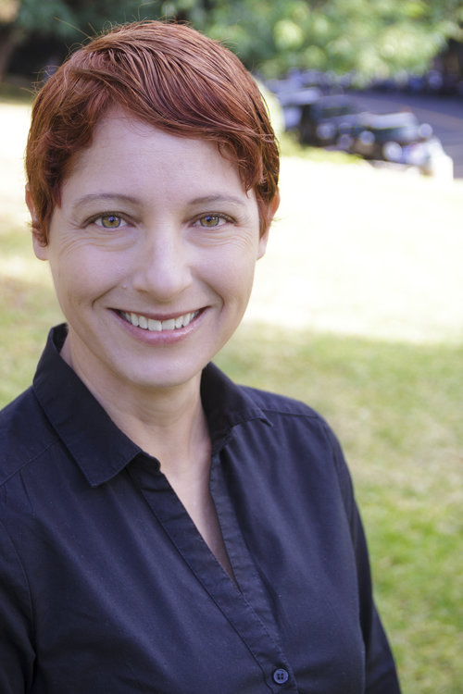
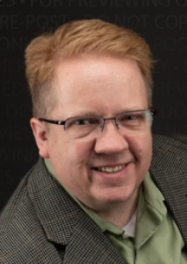
Dana Litwin, CVA, is a transformational coach, strategic advisor, and public speaker with a background in team building, environmental conservation, and sustainability. Since 2002, Dana has guided organizations in the Bay Area, Silicon Valley, and nationwide to produce breakthrough volunteer and community engagement programs, as well as board and advisory committee development. She is Past President of the Association of Leaders in Volunteer Engagement (AL!VE), and currently serves as a founder and co-facilitator of the multi-sector National Alliance for Volunteer Engagement (NAVE).
Craig Young is the founder and Executive Director of Inspiring Service and recently launched VolunteerGeneration.org as a repository for the extensive research he has sponsored on how to most effectively recruit and motivate volunteers. He also has strong background in healthcare volunteerism, having served for 8+ years on the Cincinnati Children’s Hospital Board of Trustees which included leadership of both their Education and Patient Care Committees. Craig has also served as a board member with the American Red Cross, Boy Scouts of America, Cincinnati Zoo, Ugive, ProKids (CASA), and Social Venture Partners. He has built and run several successful technology companies over his career as well.
Todd McMullin graduated in non-profit management and has 30 years experience as a technology consultant for community organizations. He is the co-founder of a United Way chapter, a local Volunteer Center, Samaritan Technologies, The Congress of Volunteer Association Administrators and the Association of Leaders in Volunteer Engagement (AL!VE). From 2001 – 2005 he directed the Disaster Help Network (DHN), the primary public mobilization system for major disasters in FL, AL, and TX). More recently he has been building strategic relationship for companies like Mission-Tracker.com and VSysOne while pursuing his passion for this Global Platform and proudly parenting his daughters.

Slide 3
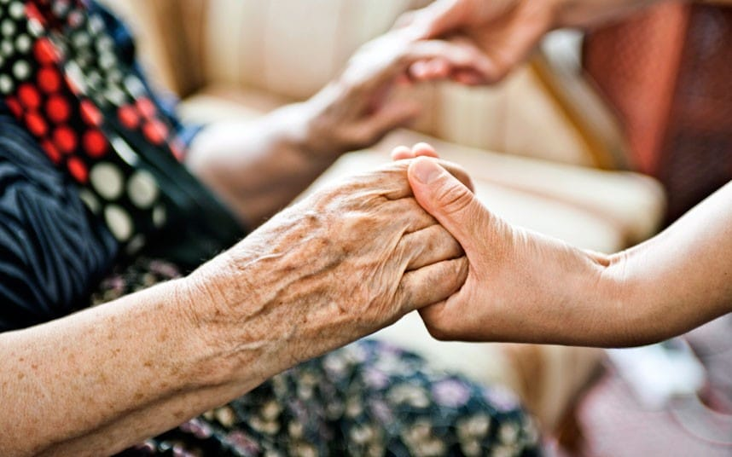
Global Giving Platform
(Description)
“Where anyone can request anything of everyone and know that they’ll be cared for.”
An idea many have dreamed of for a long time!
The “eBay for Giving”
Global all-services broker
“THE solution for de-duplication and collaboration on services.”
“New Economy technology applied to human services.”
Notes:
The National Platform has been referred to using many terms but the core concept is to directly engage with citizens and help them cross-engage with other people with or without the involvement of traditional organizations. In addition to providing a stream of personalized, high-quality giving opportunities that are matched to profiles we can facilitate citizen-driven socialized recruiting and outcome measurement so that everyone takes a greater personal stake in their communities. Research is indicating that people will pay monthly subscription fees for the convenience of easy, rapid, engagement where the usual barriers are reduced or removed; especially if they can jump between positions at different organizations easily w/o doing more paperwork.

Slide 4
Global Giving Platform
(Tactical Diagram)
Matches
Measurements
Collaborations
Governance
Volunteers
Populations
Global Giving Platform
CSR
Causes
Resources
Quantified Needs
Standards & Models
Commutable Credentials
Socialization
Needs
Donors
Communities
Care Circles
Healthcare
Philanthropy
Partners
Disasters
Commutable Credentials
Background & Certifications
Models & Standards
Quantification & Education
Notes:
As shown here the basic idea is to create a clearinghouse for giving. Anyone and everyone involved with giving or receiving the time and money from individuals is a potential partner. This includes individuals, companies, grantors, government, care circles, communities, causes, charities and countless others. If you have a need, you bring it to the ‘table’ along with whatever success measurements, trainings, partnerships and resources that will create the desired change(s) you seek. If you have a resource – or are one yourself – you also arrive at the ‘table’ and offer what you have along with your own definition(s) of a successful experience; which may include your motivations, availability, personal resources, friends-’n-family, pet causes, care circles and how you prefer to be recognized (if at all). The platform will produce streams of matching recommendations in both directions but that’s just the beginning. The real power is in the formation of care circles of people focused on a person, cause, community or project that interests them and then synergizing their passions, success definitions and resources sociocratically. This new engagement construct is like crowdfunding, but with follow-through that keeps the donors engaged with their cause until success has been achieved.

Slide 5
Global Giving Platform
(Conceptual Diagram)
Database
Existing National Databases
Integrated VMS’s
Citizen Driven Opps & Care Circles
Services
Recommendations for Giving
Background Checks
Micro-trainings
Socialization
Self-directed Engagement “Circles”
Collective Outcome Measurement
Mass Data Intake & Analysis
VolunteerNOW.com
Amalgamated, vetted opps.
Citizen Sponsorship & Recruiting
Micro-Engagements
Notes:
We envision the new platform as a catalyst for social change. By integrating existing technologies and data sources with more advanced social networks we hope to re-invigorate existing volunteers and donors while better engaging younger generations. We will start by integrating with - and expanding on - existing national data repositories for both volunteers, donors and the opportunities. As discussed previously we will add the ability for individuals to self-sponsor their own engagements based on personal observations inside their communities and enable them to also invite others via social media. Next, we will reduce current barriers which impede rapid – and even spontaneous – mobilization. Finally, we will reinforce engagements by providing relevant education and e-mentoring through an advanced Learning Network that will also facilitate locally socialized outcome measurement. That Learning Network will also connect citizens with industry professionals who become the mentors and advisors for local outcomes.

Slide 6
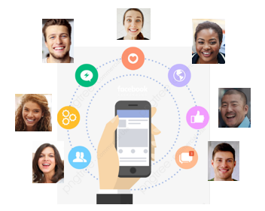
Global Giving Platform
(Core Elements)
Technology
Core platform is CRM + VMS + Social + Case Management + API
Data (the high-quality type)
VMS Integrations or acquisitions
New ‘buttons’ given to customers and volunteers for cross-posting and socialization
Sociocracy / Care Circles / Citizen-sponsored recruiting & management
Traditional agency-sponsored postings guided by AI + community advocates
Notes:
We all know the adage of “garbage in, garbage out.” Currently, the #1 volunteer matching site in the USA is suffering a 92% failure rate when it comes to recruiting and retaining volunteers; primarily due to poor content (see the analysis Craig Young’s team just published on VolunteerGeneration.org at the address shown below). It’s time to be bring engagement into the 21st century by building the new platform using the same methodologies and design concepts that empower the gaming industry and modern eCommerce platforms like Alibaba rather than staying mired in the idea that “if you build it, they will come.” In today’s world people expect the stream of personalized recommendations to appear on their phones and they want to engage with these at the touch of a button. To achieve this we must do a far better job of data gathering and quantification. This will require an ‘open network’ between VMS providers (and many of them have already agreed to help) but, more importantly, we must redesign the entire electronic engagement experience.
https://volunteergeneration.org/national-sites/

Slide 7
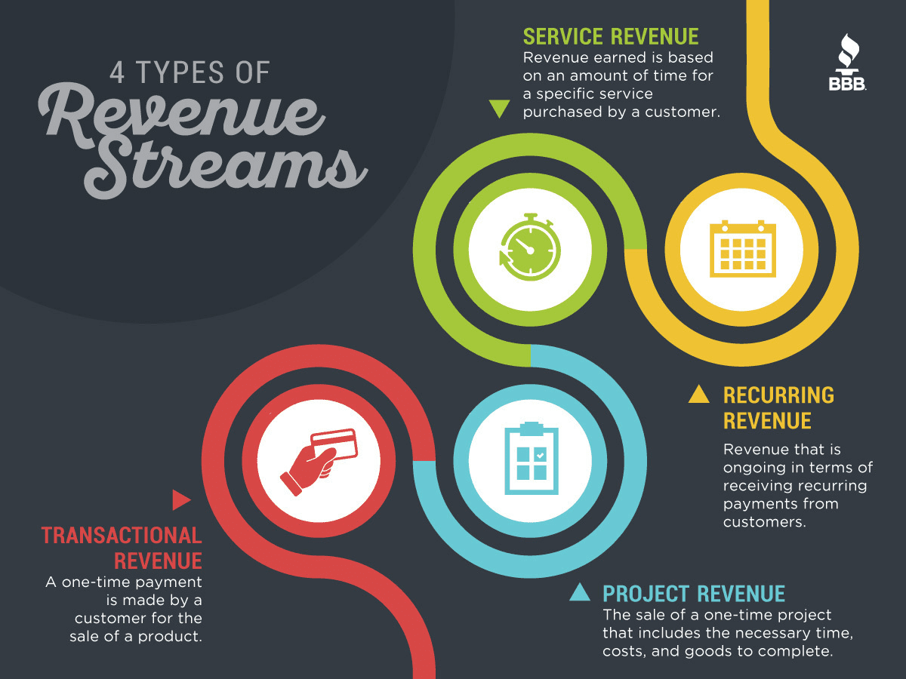
Creating a Sustainable Model
79% of volunteers donate money when asked.
(We take a %)
2. Volunteers & donors pay monthly subscription fees
(We take a %)
Value-Add’s
(VMS, fundraising supports, etc.)
4. Partnership Fees
(Data aggregation, grants, CSR, disaster mitigations, etc.)
Notes:
Over time the network will also become financially self sufficient – and even profitable – while also increasing the wealth of all participating parties. This is actually a natural byproduct of greater participation levels by people who feel more productively engaged. The most recent studies on giving trends illustrate that volunteers are financially generous and willing to be more so if doing so is made more convenient. Therefore, the entity that manages the network will could benefit from up to 3 diverse revenue streams. 1: a % of transaction fees for donations. 2. monthly subscription fees for all the services we’ve been discussing. 3. Grants from foundations, philanthropists and even traditional investors. The project should be legally independent from all stakeholders as much as possible and there are newer incorporation constructs such as ‘B’ Corporations and Low-Profit Philanthropic Corporations (L3C’s) that should be considered.
Our next steps are to identify the funding required for technical, legal and relationship R&D. The first phase will help the team finalize a series of relationships with current and additional stakeholders who will collaborate on the technical design and the incorporation work.

Slide 8
Thank-you!
Our contact info:
Dana Litwin
dana@danalitwin.com
415.823.4779
Todd McMullin
Todd.Mcmullin@gmail.com
801.450.6029
Craig Young
craig@inspiringservice.org

